Slide 1
CAU-IIKH
Interactive Intelligent Kitchen Helper
20182705 고주형 20185784 김호성
20182610 손희승 20162874 이준협
20142611 이하람

Slide 2
What “IIKH” is
IIKH
Recipe Name
Description of Recipe
Needed Ingredients
Recipe
Plan Name
Meal Plan of Breakfast Lunch Dinner
Plan
“Convenience”
of Kitchen User
Management

Slide 3


Cream Pasta Recipe ~~~~~~~~~~~ ~~~~~~~~~~~ ~~~~~~~ ~~~~~~~~~
Steak Recipe ~~~~~~~~~~~ ~~~~~~~~~~~ ~~~~~~~ ~~~~~~~~~
Fried Chicken Recipe ~~~~~~~~~~~ ~~~~~~~~~~~ ~~~~~~~ ~~~~~~~~~
Lamb Curry Recipe ~~~~~~~~~~~ ~~~~~~~~~~~ ~~~~~~~ ~~~~~~~~~
Soup Recipe ~~~~~~~~~~~ ~~~~~~~~~~~ ~~~~~~~ ~~~~~~~~~
Curry Recipe ~~~~~~~~~~~ ~~~~~~~~~~~ ~~~~~~~ ~~~~~~~~~
Steak Recipe ~~~~~~~~~~~ ~~~~~~~~~~~ ~~~~~~~ ~~~~~~~~~
Garlic Soup Recipe ~~~~~~~~~~~ ~~~~~~~~~~~ ~~~~~~~ ~~~~~~~~~
Onion Soup Recipe ~~~~~~~~~~~ ~~~~~~~~~~~ ~~~~~~~ ~~~~~~~~~

Slide 4

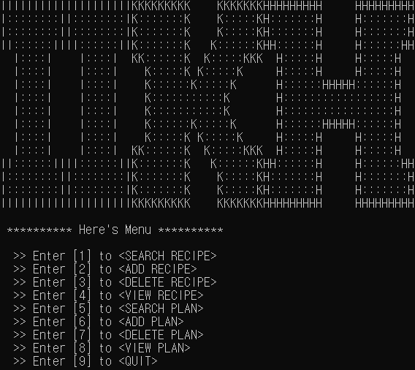
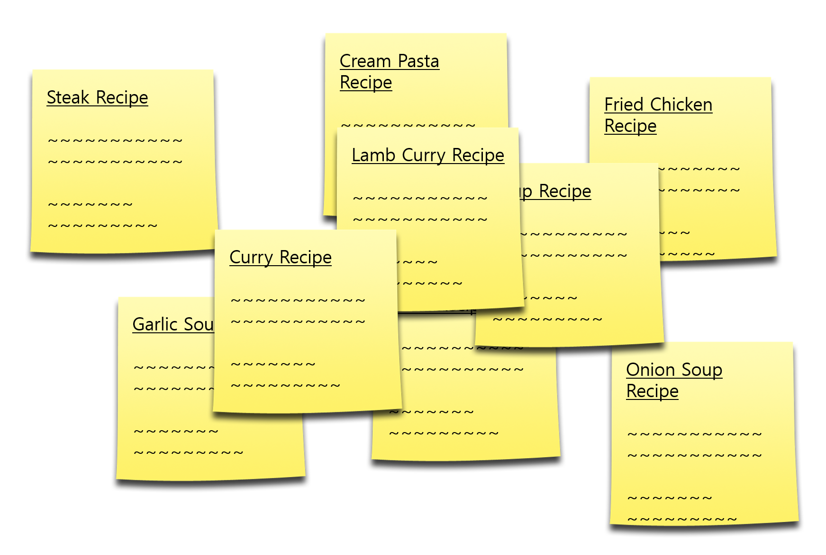

Slide 5
What we focused on
“UX”

Slide 6
“UX”
How to add recipes from internet.
Will you type everything in console?
How to share my recipe.
콘솔 창의 한계 -> 파일의 형식에 집중

Slide 7
“CSV”
How to add recipes from internet.
Will you type everything in console?
How to share my recipe.

Slide 8
Process of IIKH Project

Slide 9
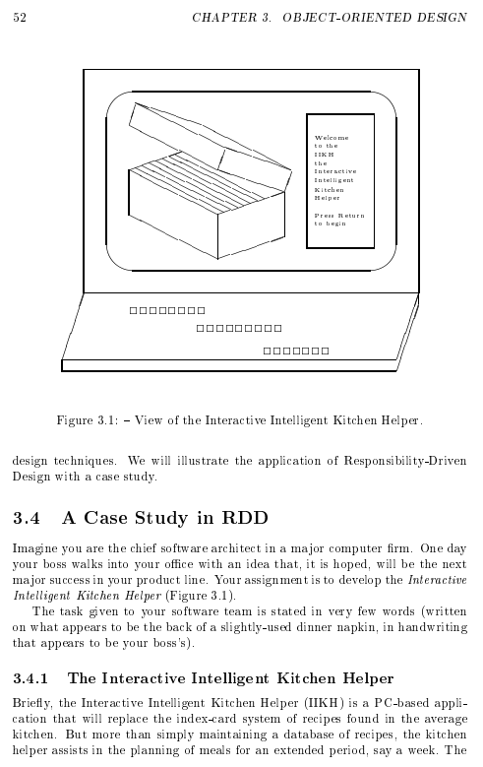
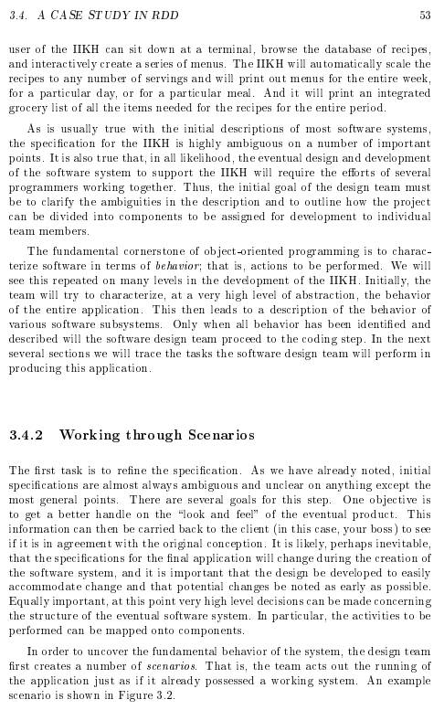
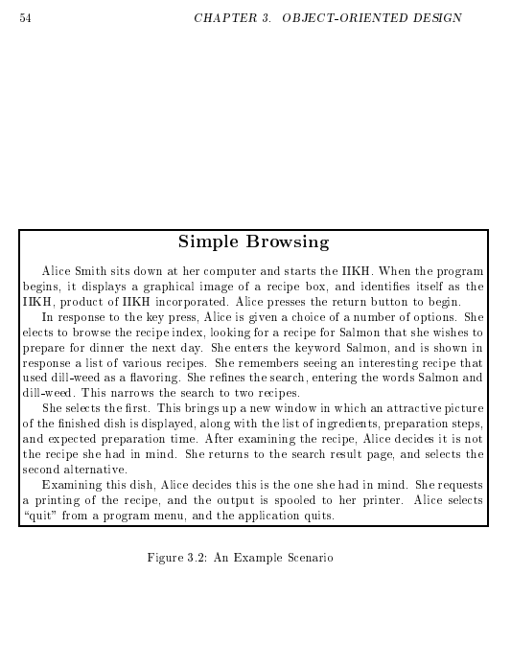
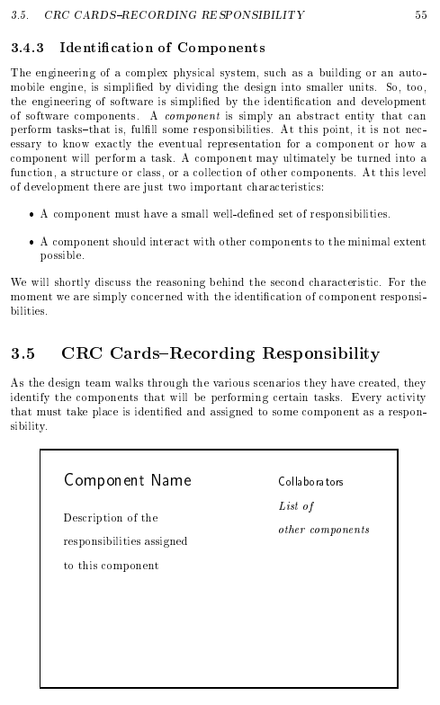
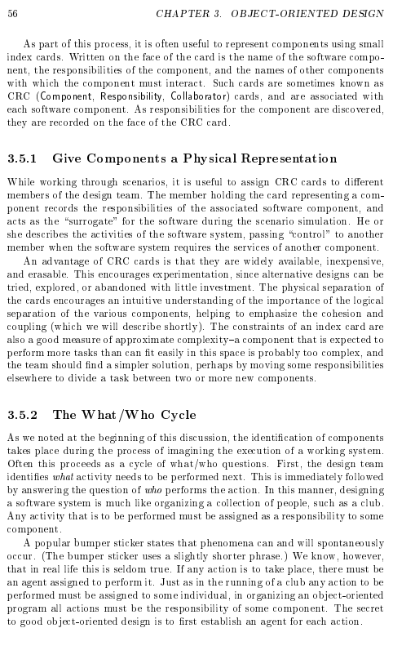
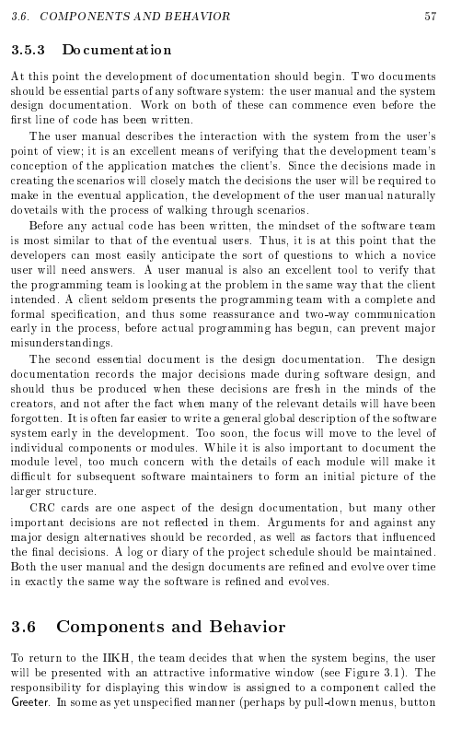
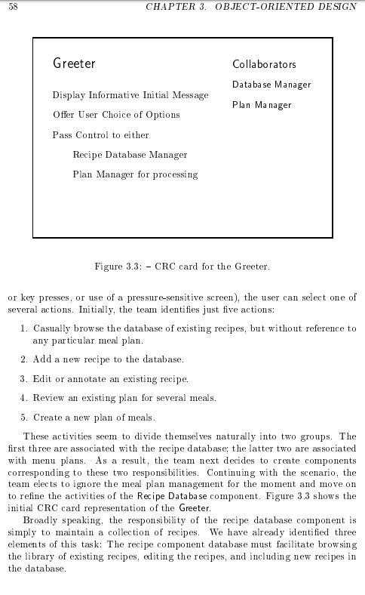
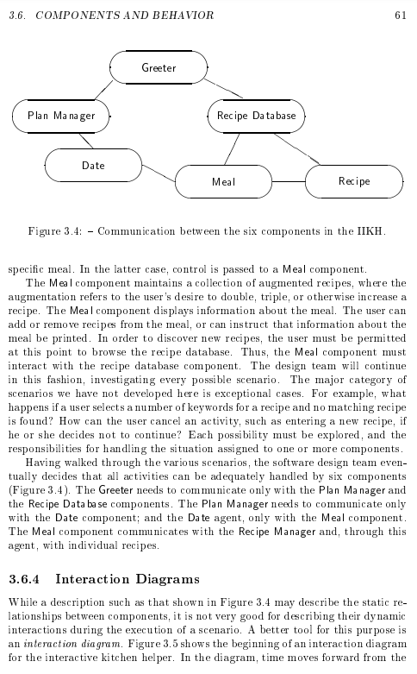
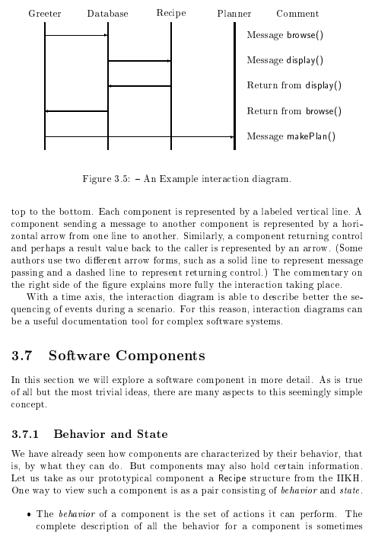
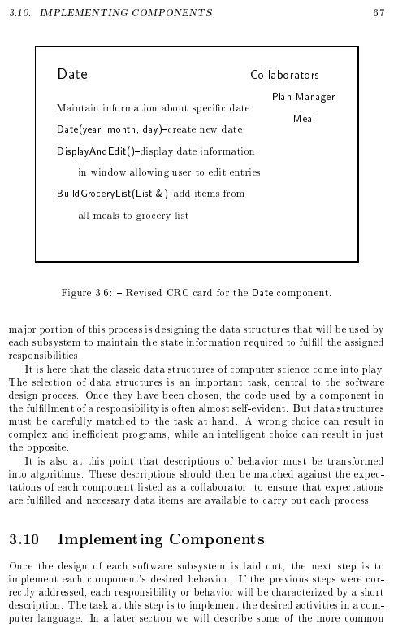
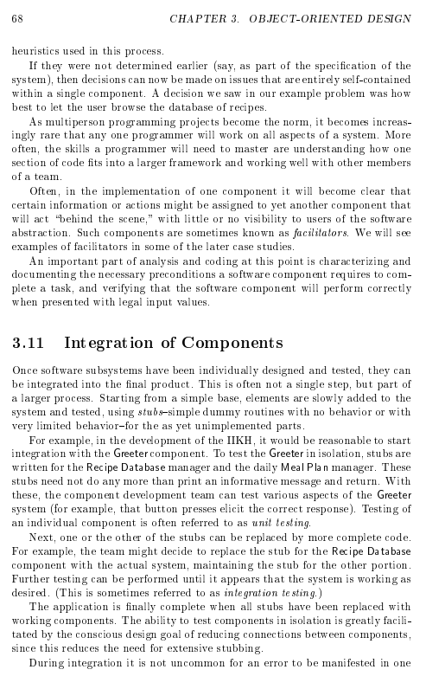
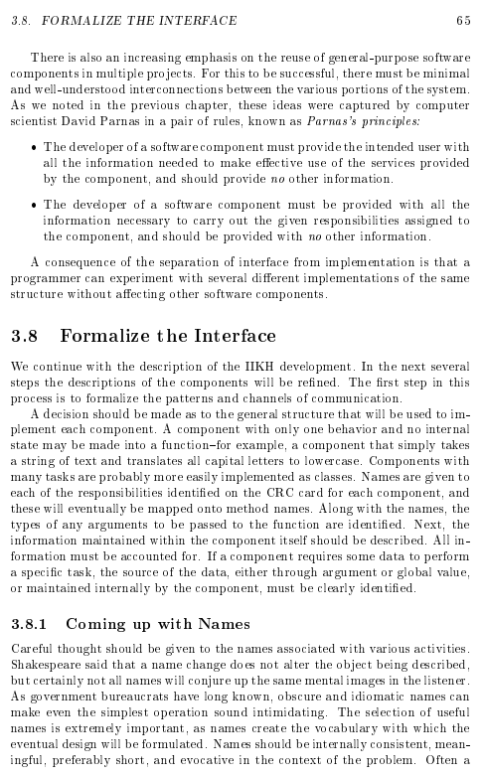
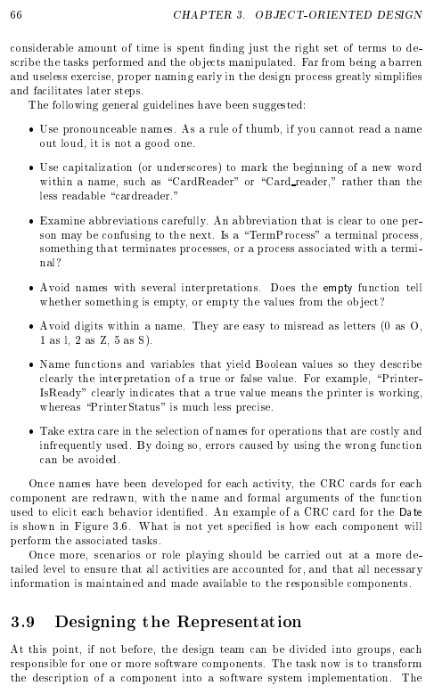
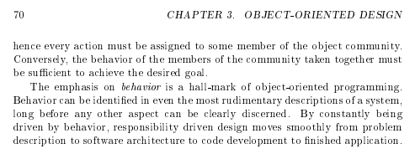
What is our Task?
Specification was ambiguous

Slide 10
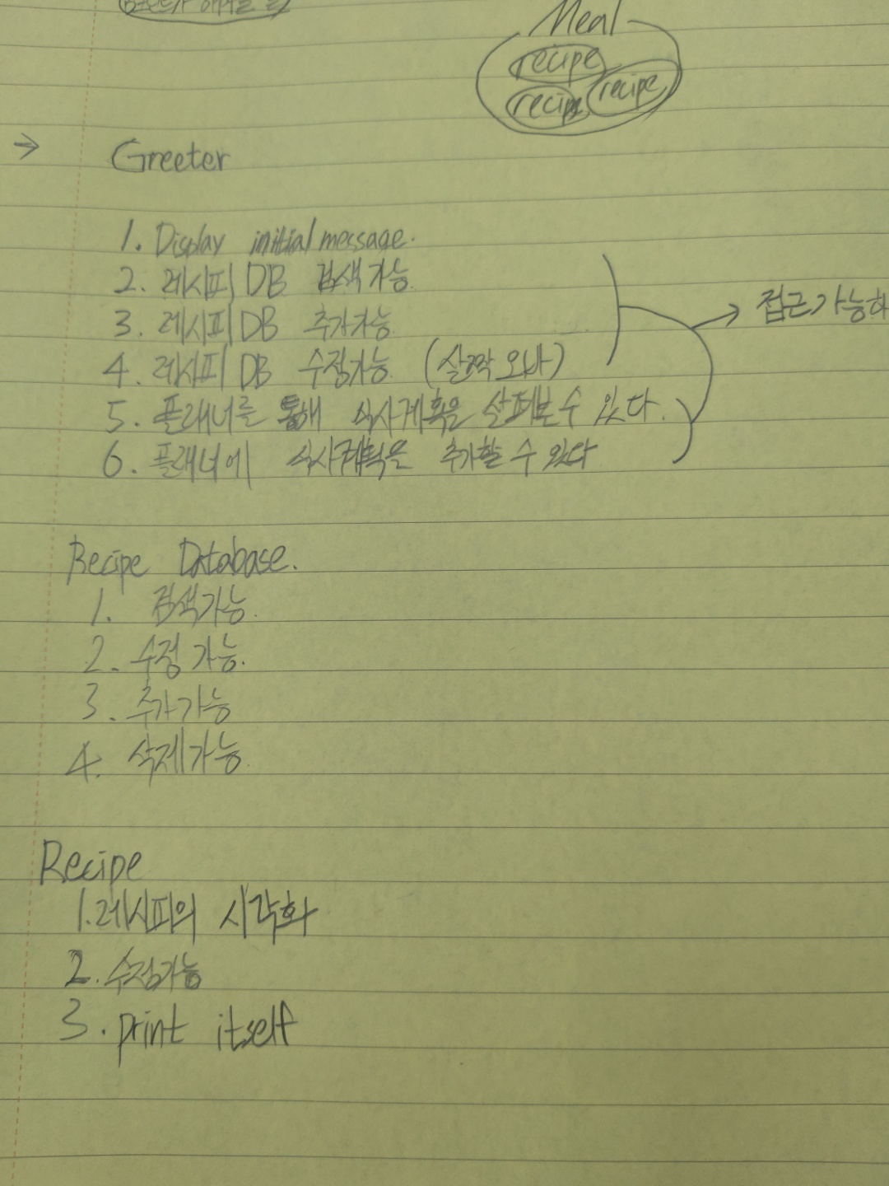
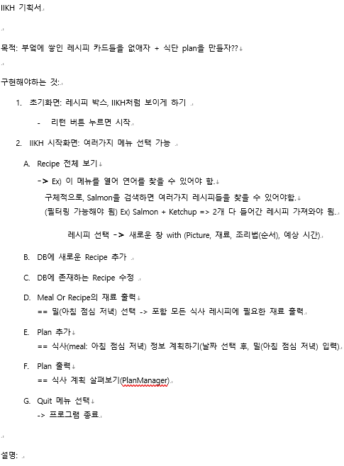
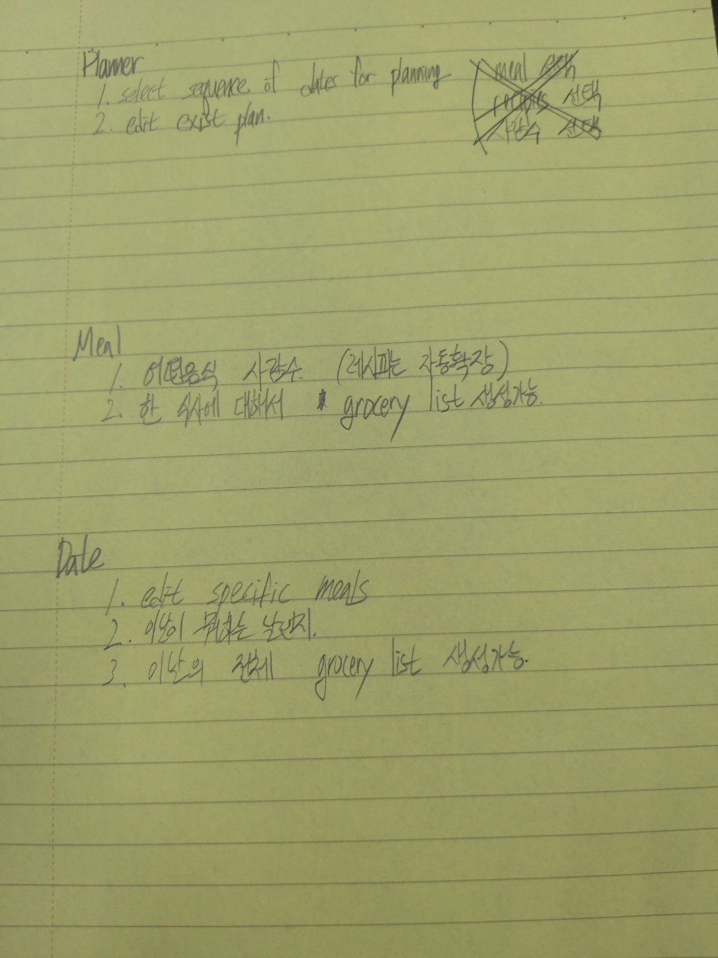
What we did
Refine Specification

Slide 11
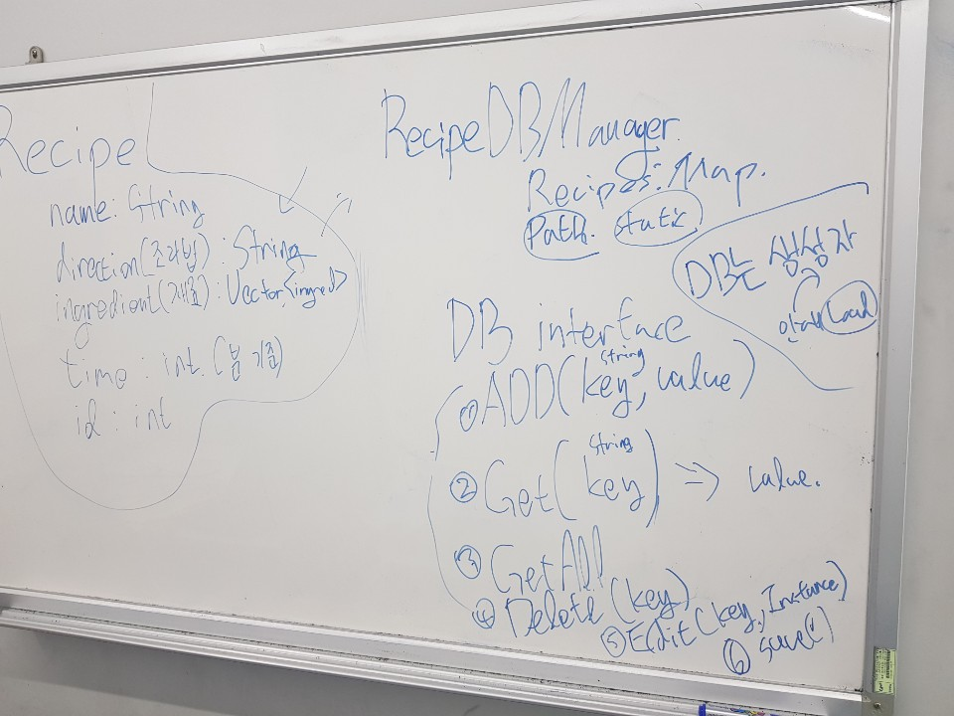
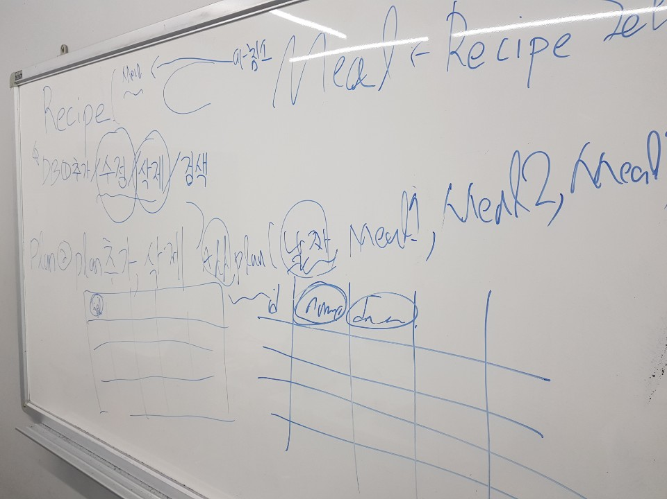
What we did
Identifying the Components

Slide 12
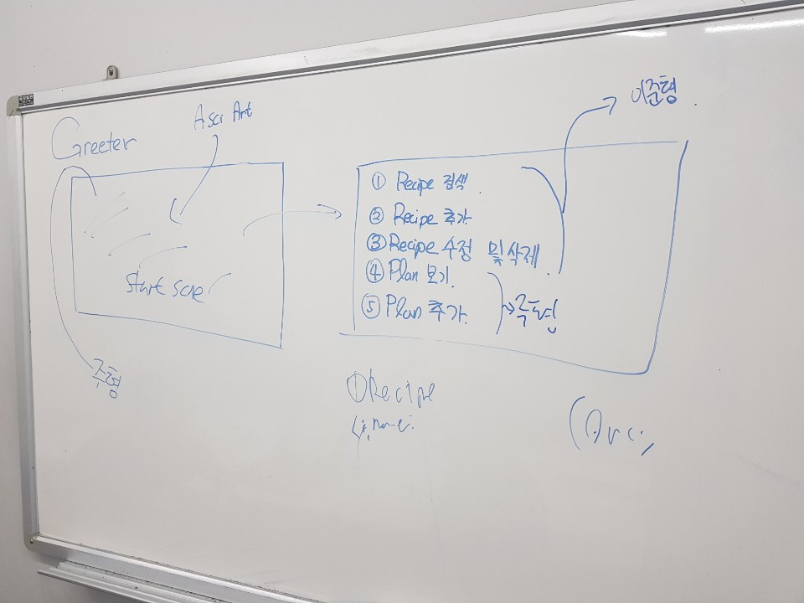
What we did
Refine Specification
Identifying the Components

Slide 13
Components we needed
What we did
Greeter
User Interface
“Design of Components”
CSV Parser
Inner Structure
“Whose Responsibility is it?”
Read csv file Write csv files
Process Data Manage Database (PlanDB/RecipeDB)
Handle Exception

Slide 14
What we did
UML

Slide 15
Encapsulation
CSV Parser
Inner
Structure
Greeter
Private
Public
Public
Private
Public
Public
Private
Hidden
Read
Write
_save
recipesDB
plansDB
Hidden
_search _delete showAll
selectMenu
Hidden
Communicate
Communicate

Slide 16
Functionality
Search Recipe
Add Recipe
Delete Recipe
View Recipe
Search Plan
Add Plan
Delete Plan
View Plan
Quit

